Slide 1
ARGIS - Atlanta Region GIS user group
March 1, 2017
Noon – 2pm
Harry West Room, Conference Level
arcopendata.com
atlantaregional.com/argis
Future meetings scheduled for June 7, Sep 6 and Dec 8- likely at Peachtree Center
WiFi credentials: AtlRegional-Guest | Community

Slide 2
Upcoming GIS Events
FREE ESRI ArcGIS User Seminar March 16 in Buckhead
Southern Data Science Conference April 7 in Atlanta
ESRI Public Sector GIS Conference (former SE/SW user Conf) April 11-13 in West Palm Beach
ESRI International User Conference July 10-14 in San Diego
Monthly GAURISA luncheon Second Tuesday, rotating locations
Monthly Georgia GIS Coordinating Committee meeting Third Wednesday, rotating locations
Others?

Slide 3
Announcements and Updates
2018 GMRC Cooperative Imagery Purchase update
Contact Faith Bryan, GMRC, at fbryan@gmrc.ga.gov or 770-538-2614
First and foremost, it’s not too late to let me know that a county is interested in participating or at least getting pricing for their area of interest - City / County Letter of Interest
Quick Facts about the GMRC 2018 Project:
Any LiDAR acquisition will be conducted under the 3DEP Grant Process
No Pictometry acquisition for this project as in 2015. If you need oblique imagery, we can get you in touch with Nathan Roberson
GMRC will prepare an RFP for the Aerial Photography to be sent out to vendors by March 15th
Quotes from vendors will be due back by April
Review committee will be comprised from participant pool
Vendor will be chosen by participants
Letters of Intent will be sent to Counties and Cities after vendor is chosen
Contracts will be between GMRC and Counties/Cities and will be sent out in October 2017 and due back to GMRC by November 2017
Flights will take place January 1 – March 2, 2018

Slide 4
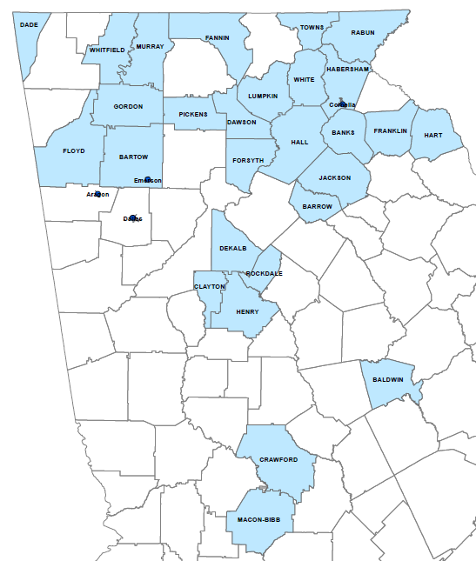
Announcements and Updates
2018 GMRC Cooperative Imagery Purchase Potential Participants

Slide 5
Announcements and Updates
Coastal RC Cooperative Imagery Purchase
Career Opportunities
Americus seeking GIS Analyst
Clayton County seeking GIS Analyst
Clayton County seeking GIS Data Coordinator
Colliers International seeking GIS Analyst
Fayette County seeking GIS Analyst
Southern Georgia Regional Commission seeking GIS Analyst
Other announcements or updates?

Slide 6
ARGIS Participation GISP Points
Confirmed with GISCI
 | First-time applicants | Renewing
Attendance | 2 hours* | 2 hours**
6 months to a year membership | 1 point | 3 points
Presentation or poster display | 1 point | 3 Points
* 4 Professional Activity hours = .1 point for first-time applicants
** 6 Professional Activity hours = 1 point for renewing applicants

